Slide 1


Current Trends in IECMHC
A NATIONAL STUDY IN PARTNERSHIP WITH CONSULTANTS ON THE ROLE OF CONSULTEE STRESS AND WELLBEING IN IECMHC

Slide 2

1
STUDY OVERVIEW AND KEY FINDINGS
HOW WE’LL MOVE THROUGH OUR TIME TOGETHER
2
PANEL DISCUSSION WITH CONSULTANTS
------------- SESSION BREAK-------------------
3
BREAK OUT ROOMS
4
LARGE GROUP INTEGRATION
5
NEXT STEPS & CLOSING

Slide 3
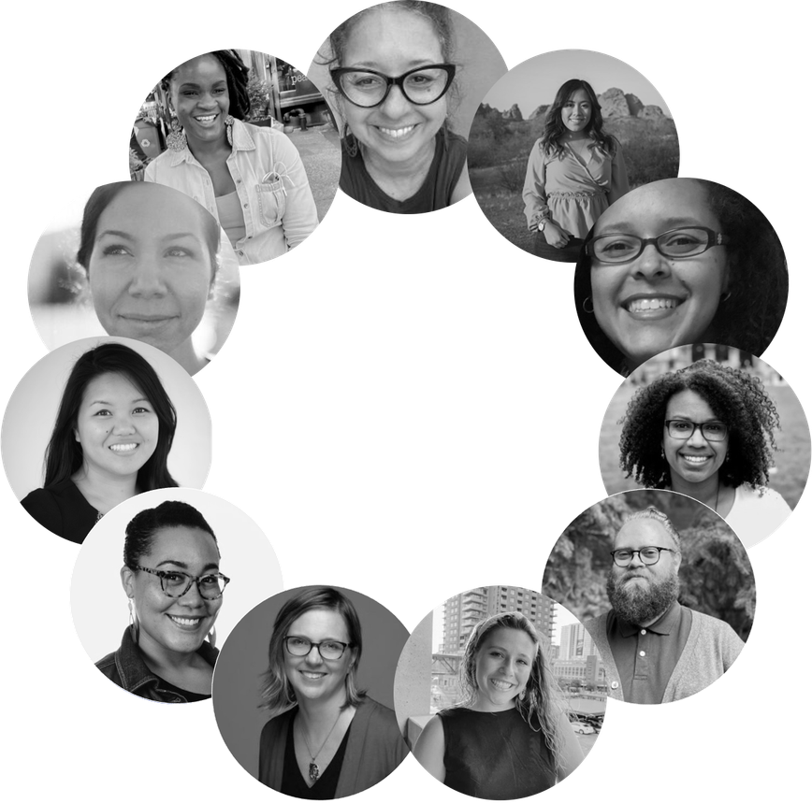

INDIGO CULTURAL CENTER
  Founded in 2007
  BIPOC led and predominantly BIPOC staffed
  Three Divisions
    Evaluation and Research
    Racial Equity IECMH Workforce Support
    Community Healing Arts
  Our divisions are interconnected by a strong commitment to social justice and a deep history of conducting research, training, and policy consultation with IECMHC initiatives around the country.
Learn more about our IECMHC work

Slide 4
WHERE THIS WORK BEGAN
PURPOSE
APPROACH
COLLABORATION
Consultants shared that they are increasingly holding educators’ personal stress, trauma, and sociopolitical pressures
This national study was created to better understand these shifts and supports needed to sustain the work.
We utilized approaches that seek to decolonize and revitalize evaluation and research.
We rely on and uplift practice-based evidence —knowledge generated from real work in real settings.
Every phase of this study was co-created with our field innovation partners. A group of consultants, initiative directors, thought leaders, and researchers to reflect real-world practice.

Slide 5
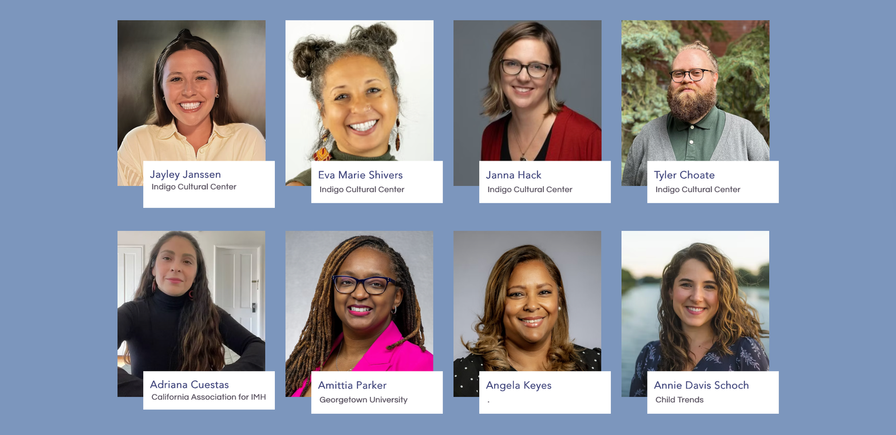
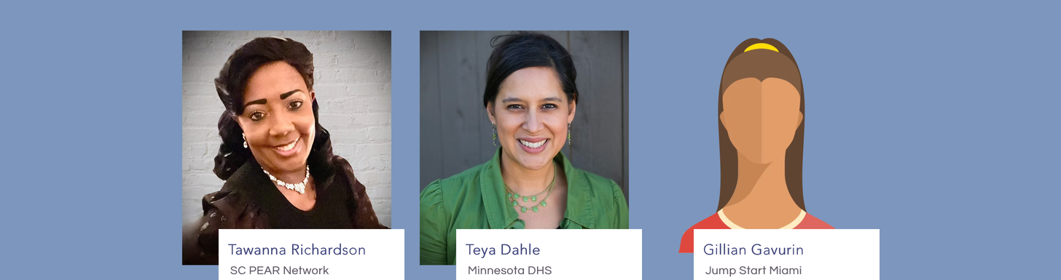

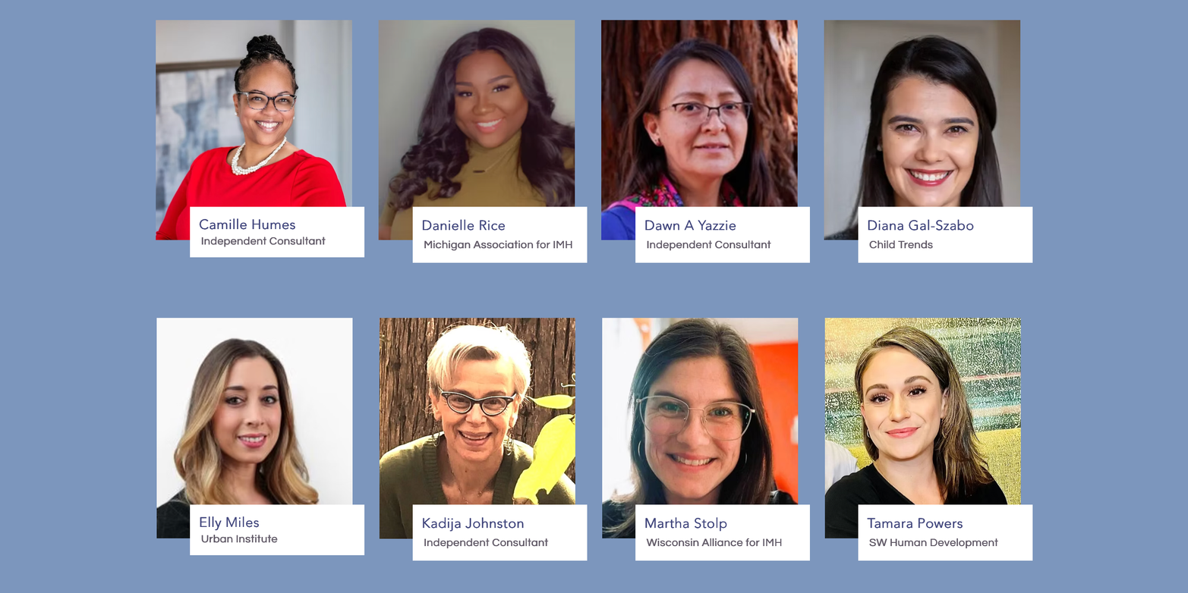


MEET OUR ‘FIELD INNOVATION PARTNERS’

Slide 6



STUDY PROCESS
NATIONAL
SURVEY (N=229)
INTERPRETATION SESSION
SEVEN (7) FOCUS GROUPS (N= 46)
INTERPRETATION SESSION

Slide 7
FOCUS GROUPINGS
STUDY PROCESS
  Migrant Groups: Two (2) groups for consultants with migration experiences who also serve communities with migration experiences.
  BIPOC Groups: Two (2) groups for BIPOC consultants who also serve BIPOC communities.
  Long-Term Experience Group: One (1) group for consultants with 15+ years of experience in IECMHC.
  Short-Term Experience Group: One (1) group for consultants with 2 to 5 years of experience in IECMHC.
  General Group: One (1) group of randomly selected consultants.
NATIONAL
SURVEY (N=229)
INTERPRETATION SESSION
SEVEN (7) FOCUS GROUPS (N= 46)

Slide 8
QUESTIONS GUIDING THIS STUDY
1
ARE CONSULTANTS NOTICING AN INCREASED LEVEL OF PERSONAL STRESS AND TRAUMA AMONG THEIR CONSULTEES?
2
WHAT IS THE IMPACT ON CONSULTANTS TO CONSISTENTLY HOLD SPACE FOR THE CURRENT LEVEL OF CONSULTEES’, STRESS AND TRAUMA?
3
IS CONSULTANT SELF EFFICACY IMPACTED BY CURRENT LEVELS OF CONSULTEE PERSONAL STRESS AND TRAUMA?
4
WHAT TRAINING, SUPPORTS, OR PRACTICES HAVE BEEN HELPFUL FOR CONSULTANTS? WHAT IS MISSING?

Slide 9
1
KEY FINDINGS
"I feel like we're holding an unprecedented amount of moral injury,
ARE CONSULTANTS NOTICING AN INCREASED LEVEL OF PERSONAL STRESS AND TRAUMA AMONG THEIR CONSULTEES?
compassion fatigue,
outrage.
There's not a week that goes by that I'm not hearing from either a consultant
or from direct service staff...
its tremendous heartbreak."

Slide 10
1
KEY FINDINGS
ARE CONSULTANTS NOTICING AN INCREASED LEVEL OF PERSONAL STRESS AND TRAUMA AMONG THEIR CONSULTEES?
“It seems that the insults are ongoing and constant. The early childhood educators that I work with you know…from the ICE raids, the ICE presence, not just on their school sites, but even being worried about coming to class and the communities.”

Slide 11

1
KEY FINDINGS
"I feel like we're holding an unprecedented amount of moral injury, compassion fatigue, outrage. There's not a week that goes by that I'm not hearing from either a consultant or from direct service staff. Tremendous heartbreak."
“It seems that the insults are ongoing and constant. The early childhood educators that I work with you know…from the ICE raids, the ICE presence, not just on their school sites, but even being worried about coming to class and the communities.”
ARE CONSULTANTS NOTICING AN INCREASED LEVEL OF PERSONAL STRESS AND TRAUMA AMONG THEIR CONSULTEES?
Yes. Consultants are holding increased levels of consultee personal stress and trauma that has accumulated since COVID and has not receded. This pattern was clear and consistent across groups.
Importantly, although consultants often feel that holding elevated teacher personal stress and trauma can extend beyond traditional consultation scope, the majority did not treat it as outside their role.
Reasons for increased consultee personal stress and trauma
  Structural and policy instability
  Sociopolitical fear and surveillance
  Organizational strain and workforce depletion
  Child and community level impacts
MANY CONSULTANTS ALSO EXPERIENCE THESE STRESSORS

Slide 12
2
KEY FINDINGS
WHAT IS THE IMPACT ON CONSULTANTS TO CONSISTENTLY HOLD SPACE FOR THE CURRENT LEVEL OF CONSULTEES’ PERSONAL STRESS AND TRAUMA?
"It's really, really hard.
I think in some weeks, I'm not sleeping.
It's really heavy.
It's exhausting.
I want some sense of control or support when things just feel so so terrible."

Slide 13
2
KEY FINDINGS
"It could feel business as usual, but it's not. It's me dissociating.
WHAT IS THE IMPACT ON CONSULTANTS TO CONSISTENTLY HOLD SPACE FOR THE CURRENT LEVEL OF CONSULTEES’ PERSONAL STRESS AND TRAUMA?
It's me in fix it mode.
I feel sometimes cold, people telling really hard stories, and I'm like "Oh ... okay ..."
It is my way of... almost compartmentalizing."

Slide 14
2
KEY FINDINGS
“One of my teachers had confided in me that her father was detained, and it was just absolutely devastating.
I am a daughter of an immigrant ...
wife of an immigrant ...
It brought up a lot in me …and it really pushed me to find resources for her and even her family, which is kind of out of the scope, in a way,
of our role.”
WHAT IS THE IMPACT ON CONSULTANTS TO CONSISTENTLY HOLD SPACE FOR THE CURRENT LEVEL OF CONSULTEES’ PERSONAL STRESS AND TRAUMA?

Slide 15
2
KEY FINDINGS
"It's really, really hard. I think in some weeks, I'm not sleeping, It's really heavy. It's exhausting. I want some sense of control or support when things just feel so so terrible."
"It could feel business as usual, but it's not. It's me dissociating. It's me in fix it mode. I feel sometimes cold, people is telling really hard stories, and I'’m like "Oh, okay." It is my way of, almost compartmentalizing"
“One of my teachers had confided in me that her father was detained, and it was devastating. I'm a daughter of an immigrant, wife of an immigrant. It brought up a lot in me…and it really pushed me to find resources for her and even her family, which is kind of out of the scope, in a way,
of our role.”
WHAT IS THE IMPACT ON CONSULTANTS TO CONSISTENTLY HOLD SPACE FOR THE CURRENT LEVEL OF CONSULTEES’ PERSONAL STRESS AND TRAUMA?
Embodied and somatic impacts. Holding this level of consultee stress is carried in the body. Participants named headaches, migraines, and dissociation.
  BIPOC participants and participants with migration experiences emphasized these more.
Shared marginalized identities and sociopolitical harms between consultant and consultee intensify impacts.
Isolation compounds the toll. Discussion of isolation came in many forms, like being one of the only BIPOC consultants or the only consultant with immigration experience in an agency or serving rural or geographically large regions alone.

Slide 16

2
KEY FINDINGS
"It's really, really hard. I think in some weeks, I'm not sleeping, It's really heavy. It's exhausting. I want some sense of control or support when things just feel so so terrible."
"It could feel business as usual, but it's not. It's me dissociating. It's me in fix it mode. I feel sometimes cold, people is telling really hard stories, and I'’m like "Oh, okay." It is my way of, almost compartmentalizing"
“One of my teachers had confided in me that her father was detained, and it was devastating. I'm a daughter of an immigrant, wife of an immigrant. It brought up a lot in me…and it really pushed me to find resources for her and even her family, which is kind of out of the scope, in a way,
of our role.”
WHAT IS THE IMPACT ON CONSULTANTS TO CONSISTENTLY HOLD SPACE FOR THE CURRENT LEVEL OF CONSULTEES’ PERSONAL STRESS AND TRAUMA?
HOLDING CONSULTEE STRESS AND TRUAMA
CAN BE A MURKY, MIXED EXPERIENCE
Embodied and somatic impacts. Holding this level of consultee stress is carried in the body. Participants named headaches, migraines, and dissociation.
  BIPOC participants and participants with migration experiences emphasized these more.
Shared marginalized identities and sociopolitical harms between consultant and consultee intensify impacts.
Isolation compounds the toll. Discussion of isolation came in many forms, like being one of the only BIPOC consultants or the only consultant with immigration experience in an agency or serving rural or geographically large regions alone.
“And they're frantic ... and you're there.
You're holding space for them, right?
Because you're their consultant.
So that tells you they trust you, they see you are a safe space for them because they don't know where to go next.“

Slide 17
2
KEY FINDINGS
"It's really, really hard. I think in some weeks, I'm not sleeping, It's really heavy. It's exhausting. I want some sense of control or support when things just feel so so terrible."
"It could feel business as usual, but it's not. It's me dissociating. It's me in fix it mode. I feel sometimes cold, people is telling really hard stories, and I'’m like "Oh, okay." It is my way of, almost compartmentalizing"
“One of my teachers had confided in me that her father was detained, and it was devastating. I'm a daughter of an immigrant, wife of an immigrant. It brought up a lot in me…and it really pushed me to find resources for her and even her family, which is kind of out of the scope, in a way,
of our role.”
WHAT IS THE IMPACT ON CONSULTANTS TO CONSISTENTLY HOLD SPACE FOR THE CURRENT LEVEL OF CONSULTEES’ PERSONAL STRESS AND TRAUMA?
HOLDING CONSULTEE STRESS AND TRUAMA
CAN BE A MURKY, MIXED EXPERIENCE
Embodied and somatic impacts. Holding this level of consultee stress is carried in the body. Participants named headaches, migraines, and dissociation.
  BIPOC participants and participants with migration experiences emphasized these more.
Shared marginalized identities and sociopolitical harms between consultant and consultee intensify impacts.
Isolation compounds the toll. Discussion of isolation came in many forms, like being one of the only BIPOC consultants or the only consultant with immigration experience in an agency or serving rural or geographically large regions alone.
Consultants described holding these levels of consultee personal stress was not a simple positive or negative experience.
  Makes it harder to “leave things at the door.”
  Increase emotional burden.
  Make it harder to separate work and self.
  Signals trust and relational depth.
  Increases motivation, especially for newer consultants.
{ AND }

Slide 18
3
KEY FINDINGS
“I’m holding the teachers and feel like they’re feeling supported but I often continue to see little change or inconsistent change in terms of their interactions and engagement with the children ... the demands these teachers face and the stressors seems to continue to get in the way and impact the relational climate of the classroom.”
IS CONSULTANT SELF EFFICACY IMPACTED BY CURRENT LEVELS OF CONSULTEE PERSONAL STRESS AND TRAUMA?

Slide 19
3
KEY FINDINGS
IS CONSULTANT SELF EFFICACY IMPACTED BY CURRENT LEVELS OF CONSULTEE PERSONAL STRESS AND TRAUMA?
“I think everyone is in survival mode and barely keeping it together. I feel privileged to do this work, but also have a strong sense of imposter syndrome and feeling like I'm not doing enough."

Slide 20
3
KEY FINDINGS
“We have so many meetings and, like, all these protocols, and trainings, and checklists,
and no one's actually talking about the stuff we are really going through to
meet other people's needs constantly.
IS CONSULTANT SELF EFFICACY IMPACTED BY CURRENT LEVELS OF CONSULTEE PERSONAL STRESS AND TRAUMA?
You look out in the news ... and it's like ... oh ... don't forget the FAN ... and it feels like dystopian in the way that ... like some of these tools for the environments that we're currently in may not be appropriate at this time.
It's like we're just at the point of humanity sometimes, of just two humans that don't know the answer, just hold the space for each other, standing by each other, letting go of the expectations of whatever title you have.
But sometimes it just feels negligent to me, to the point where it's like,
in some of my supervisions, I'm not really getting my needs met
because of the talking around the issue.”

Slide 21
3
KEY FINDINGS
“I am holding the teachers and feel
like they are feeling supported but I often see little change or inconsistent change in terms of their interactions and engagement with the children. The demands these teachers face and the stressors seems to get in the way and impact the relational climate of the classroom.”
“I think everyone is in survival mode and barely keeping it together. I feel privileged to do this work, but also have a strong sense of imposter syndrome and feeling like I'm not doing enough."
“We have so many meetings, protocols, trainings, and checklists, and no one's actually talking about the stuff we are really going through to meet other people's needs constantly...”
IS CONSULTANT SELF EFFICACY IMPACTED BY CURRENT LEVELS OF CONSULTEE PERSONAL STRESS AND TRAUMA?
It depends. All participants agreed that rising consultee stress often stalls “traditional” outcome markers of growth and change.
  Some mental health consultants named stalling can plummet self-efficacy, while others redefined effective IECMHC.
Constraining Factors:
  Outcome-only evaluation; controlling and high-stress ECE systems; lack of reflective space; high caseloads with little rest or transition time.
Protective Factors
  Reflective supervision that validates holding increased personal stress is “the work” and supports authentic processing; Flexibility.

Slide 22
4
KEY FINDINGS
“I think that we were not super prepared for how many of the teachers had their own personal traumas to process.
I'm still seeing ... teachers bringing that same type of a trauma history and stress that they are experiencing.”
WHAT TRAINING, SUPPORTS, OR PRACTICES HAVE BEEN HELPFUL FOR CONSULTANTS, AND WHAT IS MISSING?

Slide 23
4
KEY FINDINGS
“I feel like I've been
more tapping into that
type of support ...
like prayers and chants.
Especially when I know it's been a challenging classroom or a challenging teacher – that helps me stay grounded.
Also, I'm asking and acknowledging my ancestors and asking for help.“
WHAT TRAINING, SUPPORTS, OR PRACTICES HAVE BEEN HELPFUL FOR CONSULTANTS, AND WHAT IS MISSING?

Slide 24
4
KEY FINDINGS
“Something that my program director always reminds me,
that when I feel unsure what to do,
WHAT TRAINING, SUPPORTS, OR PRACTICES HAVE BEEN HELPFUL FOR CONSULTANTS, AND WHAT IS MISSING?
is that I'm sowing seeds.
For me, one of the most challenging sites-a site where the teachers are, you know, they're struggling, and they lack the resources and the time and the capacity to rest up, get trainings, and do better.
And so that's when I need to throw away all my checklists and toolkits ... I don't know what to give them when they
don't ask for it, and I feel like they're not ... and that shows
me that they're not ready ... And ... I just ... I just tell
myself to just show up ... I don't know what kind of plant
it will be ... but one day ... we'll sprout.”

Slide 25
4
KEY FINDINGS
“I think that we were not super
prepared for how many of the teachers had their own personal traumas to process. I'm still seeing teachers bringing that same type of trauma history and stress that they're experiencing.”
“I feel like I've been more tapping into support, like prayers and chants, especially when I know it's a challenging classroom or challenging teacher and that helps me stay grounded. Also, I'm acknowledging my ancestors and asking for help.”
“Something that my program director always reminds me, that when I feel unsure what to do is that I'm sowing seeds….and I just, I just tell myself to just show up. I don't know what kind of plant it will be, but one day we'll sprout.”
WHAT TRAINING, SUPPORTS, OR PRACTICES HAVE BEEN HELPFUL FOR CONSULTANTS, AND WHAT IS MISSING?
Reflective supervision was noted as the primary structure supporting the work, though the effectiveness varied.
  Across groups, reflective supervision was noted as effective when supervisors emphasize that holding consultee personal stress is “the work” (even if metrics/eval disagree).
IECMHC training was NOT noted as a source of support or preparation.
Instead, consultants leaned on
  Their own personal background experiences
  Embodied practices
  Spiritual practices
  Experiential supports

Slide 26
LISTENING TO IECMH CONSULTANTS
THANK YOU TO OUR PANELISTS
Adalinda Sanchez
Dr. Danielle Rice
Gillian Gavurin
Tawanna Richardson

Slide 27
SESSION BREAK

Slide 28
BREAKOUT ROOMS
WHAT WOULD IT LOOK LIKE FOR IECMHC YSTEMS TO CARE FOR CONSULTANTS AS MUCH AS CONSULTANTS CARE FOR OTHERS?
(s)

Slide 29
COLLECTIVE REFLECTION
INTEGRATING INSIGHTS AND FEELINGS THAT SURFACED IN SMALL GROUPS TO COME TOGETHER AND BE WITNESSED BY THE FULL COMMUNITY

Slide 30
JOIN THE NATIONAL TRENDS WORKING GROUP
A COLLECTIVE EXPERIENCE DESERVES COLLECTIVE ACTION!
We invite systems leaders, evaluators, IECMH consultants, and reflective supervisors to join us in responding to what we have heard. To create meaningful change within our own roles and spheres of influence.
A six-month series where we will:
  Continue metabolizing these findings
  Engage in shared implication-making
  Document changes that emerge in response to the stories and data that consultants shared.

Slide 31


OUR CLOSING OFFERING:
‘CARRY THIS’ COLLECTIVE ACTION VIDEO
(COMPILED BY NATASHA PÉREZ BYARS)
JOIN OUR MAILING LIST

